Slide 1
trees

Slide 2
CONCEPT OF TREE ABSTRACT DATA TYPE
A tree is a nonlinear data structure, compared to arrays, linked lists, stacks and queues which are all linear data structures.

Slide 3
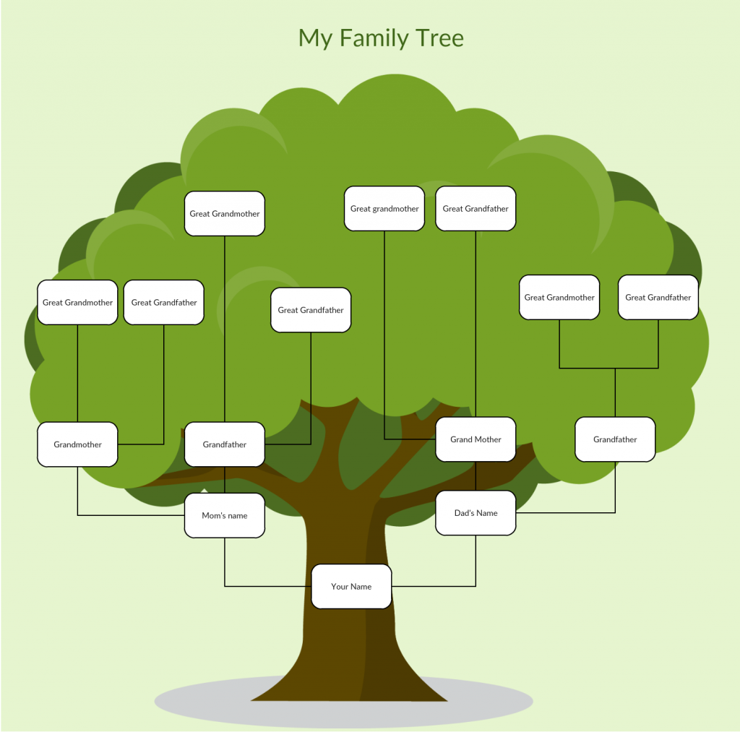
Tree ADT
A tree stores data hierarchically.
Think of a family tree with generations – grandparents , parents, siblings, etc.

Slide 4
TREE DATA STRUCTURES
There are many data structures based on the Tree ADT
We are going to focus on Binary Trees and Binary Search Trees in this chapter.

Slide 5
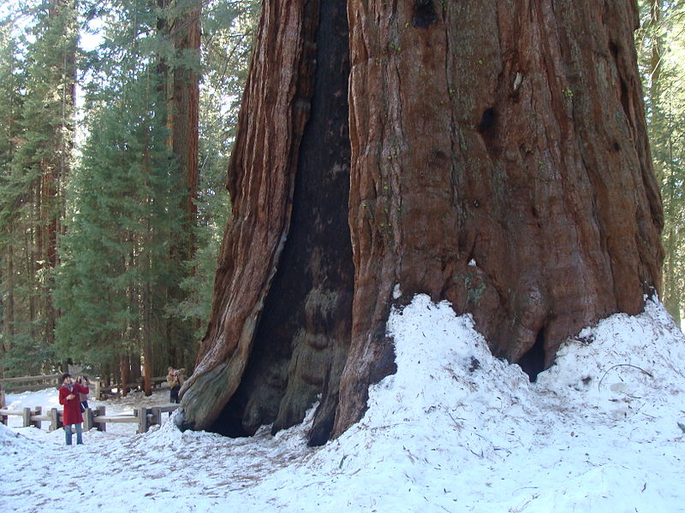
BINARY TREES
“The General Sherman Tree in California's Sequoia National Park is the largest tree, by volume, anywhere in the world. Measurements taken in 1975 marked its volume at slightly over 52,500 cubic feet, or more than half the volume of an Olympic-sized swimming pool.”
http://mentalfloss.com/article/63667/15-worlds-most-famous-trees

Slide 6
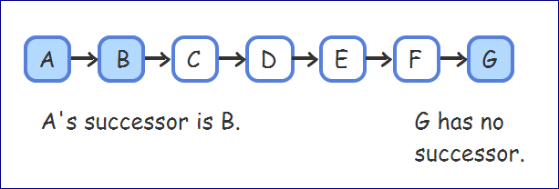
Linked List vs. Binary Tree
A Linked List has nodes. Each node has a link to the next node in the list

Slide 7
Linked List vs. Binary Tree
ROOT
A Binary Tree is a nonlinear linked list in which each node may point to 0, 1, or two other nodes
Each node contains one or more data fields and two pointers
null
null
null
null
null
null

Slide 8

Binary Tree Terminology
“The Lone Cypress is a Monterey cypress tree in Pebble Beach, California. Standing on a granite hillside off the 17-Mile Drive, the tree is a Western icon, and has been called one of the most photographed trees in North America.”
https://en.wikipedia.org/wiki/Lone_Cypress

Slide 9
Binary Tree Terminology
.
Tree pointer: like a head pointer for a linked list, it points to the first node in the binary tree
Root node: the node at the top of the tree.
ROOT
null
null
null
null
null
null

Slide 10
Binary Tree Terminology
Leaf nodes: nodes that have no children
The nodes containing 7 and 43 are leaf nodes
ROOT
31
19
59
7
null
43
null
null
null
null
null

Slide 11
Binary Tree Terminology
Child nodes, children are nodes below a given node
Nodes 19 and 59 are CHILDREN of node 31.
ROOT
31
19
59
7
null
43
null
null
null
null
null

Slide 12
Binary Tree Terminology
Parent node: node above a given node
31 is the PARENT node of nodes 19 & 59.
ROOT
31
19
59
7
null
43
null
null
null
null
null

Slide 13
Binary Tree Terminology
ancestors: all nodes above a given node
31 & 19 are ANCESTORS of node 7
ROOT
31
19
59
7
null
43
null
null
null
null
null

Slide 14
Binary Tree Terminology
ROOT
The edge is the link from a node to a child
31
19
59
7
null
43
null
null
null
null
null

Slide 15
Binary Tree Terminology
Internal nodes are nodes that have at least one child
Nodes 31, 19, and 59 are INTERNAL NODES.
ROOT
31
19
59
7
null
43
null
null
null
null
null

Slide 16
Binary Tree Terminology
Subtree is the portion of a tree from a node down to the leaves
The nodes containing 19 and 7 are the left subtree of the node containing 31
ROOT
31
19
59
7
null
43
null
null
null
null
null

Slide 17
Binary Tree terminology
The depth of the binary tree is the number of edges on the path from the root to the node
ROOT
DEPTH = 0
DEPTH = 1
DEPTH = 2
null
null
null
null
null
null

Slide 18
Binary Tree terminology
All nodes with the same depth form a tree LEVEL.
ROOT
DEPTH = 0
LEVEL 0
DEPTH = 1
LEVEL 1
DEPTH = 2
null
null
LEVEL 2
null
null
null
null

Slide 19
Binary Tree terminology
A tree’s height is the tree’s largest depth of all nodes in the tree.
ROOT
DEPTH = 0
LEVEL 0
DEPTH = 1
LEVEL 1
HEIGHT = 2
DEPTH = 2
null
null
LEVEL 2
null
null
null
null

Slide 20
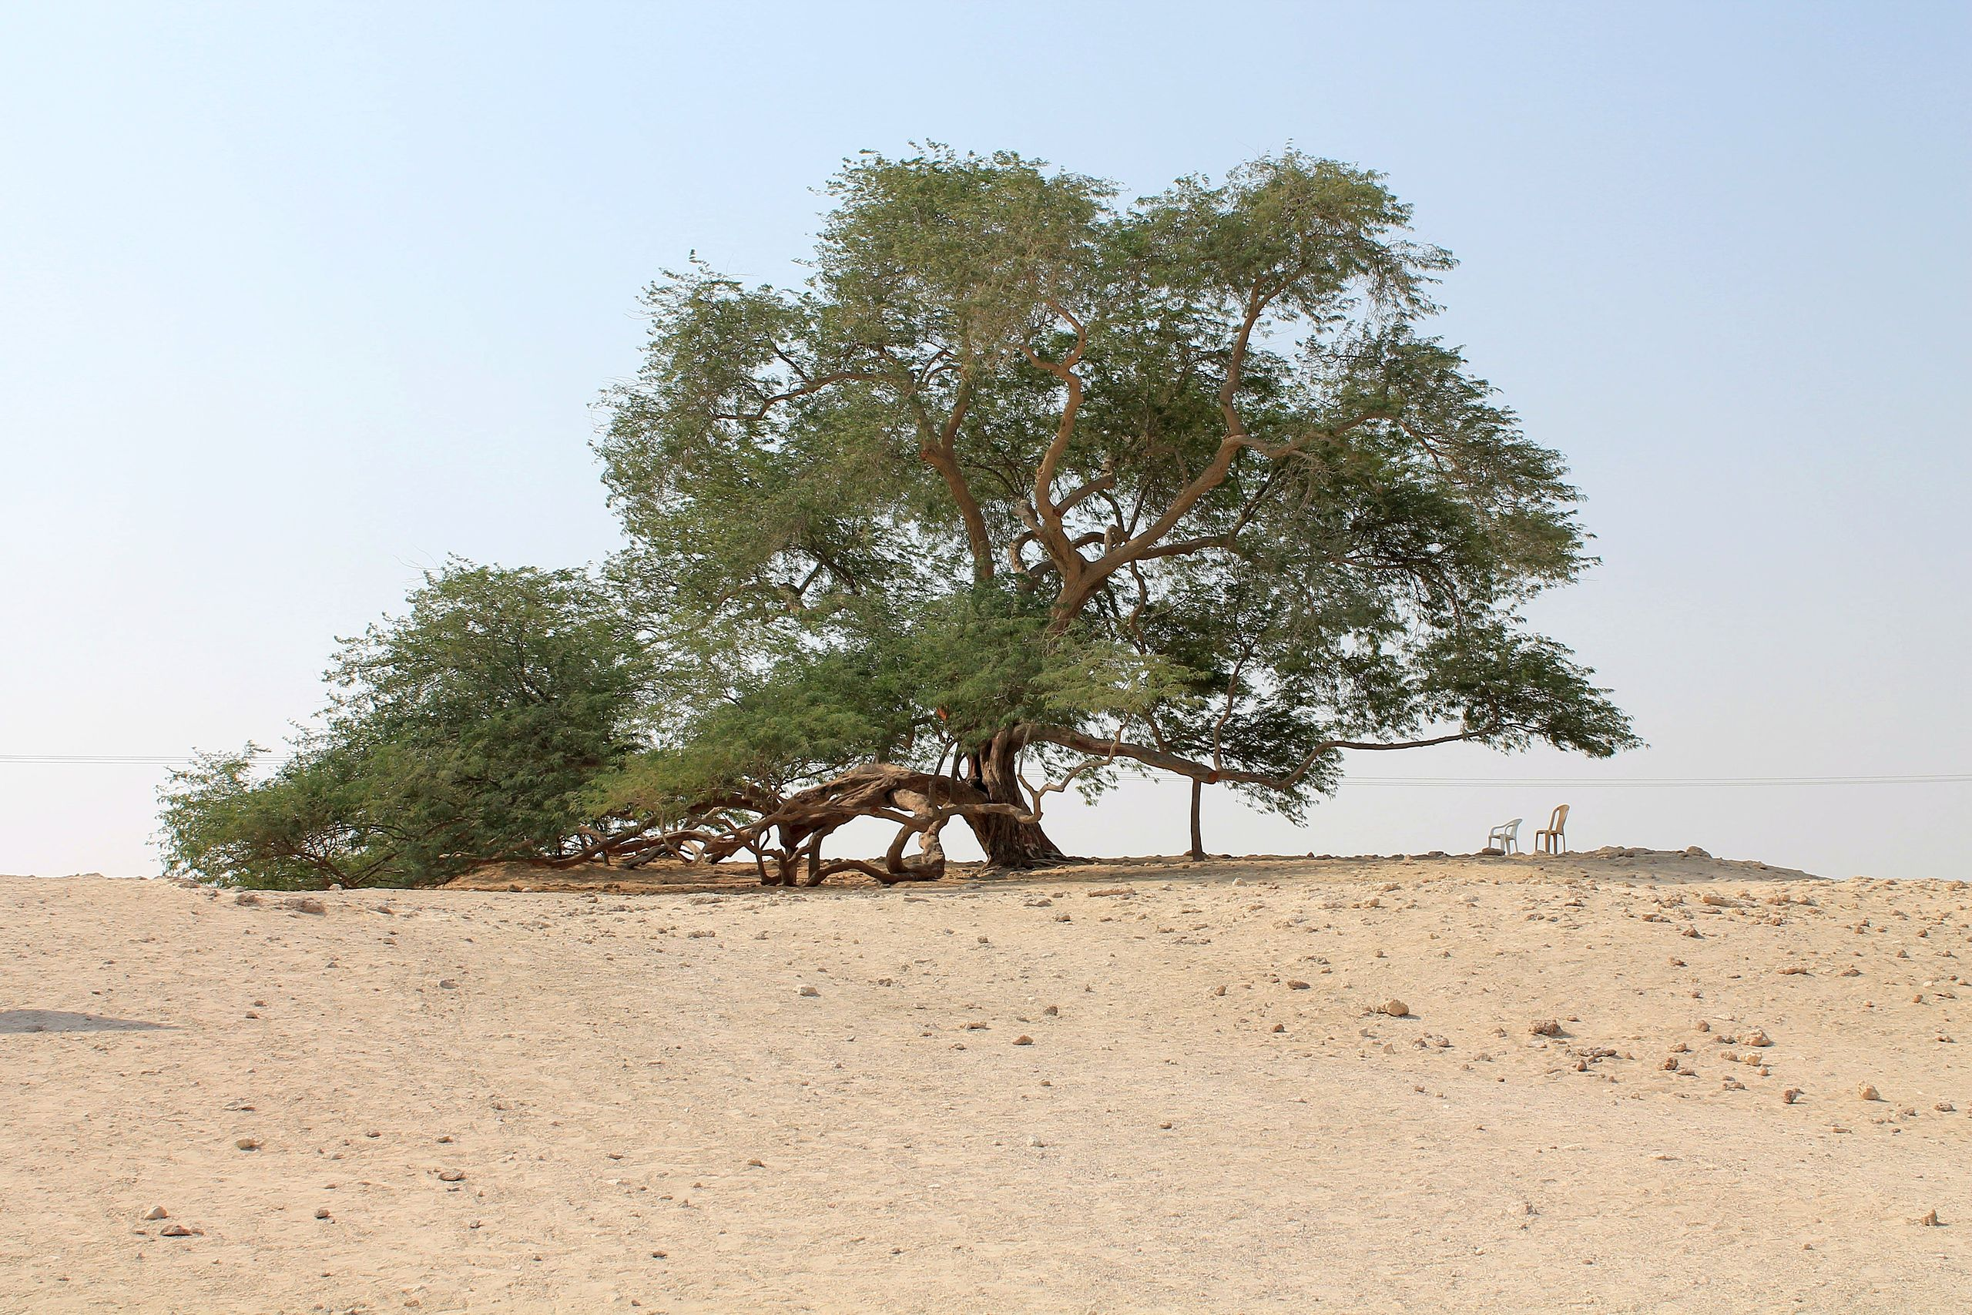
Binary search trees
“The Tree of Life in Bahrain is an approximately 400-year-old, 32 feet high and located on a hill in the Arabian Desert surrounded by miles of sand. The average temperature in the region is 105°F and sandstorms are common. It is not certain how the tree survives.”
https://en.wikipedia.org/wiki/Tree_of_Life,_Bahrain
By Alawadhi3000 - Transferred from en.wikipedia to Commons by Hekerui., CC BY-SA 3.0, https://commons.wikimedia.org/w/index.php?curid=24407096

Slide 21
Binary Search Trees
A binary search tree is a binary tree where data is organized in order to simplify searches
ROOT
Left subtree of a node contains data values < the data in the node
Right subtree of a node contains values > the data in the node
31
19
59
7
null
43
null
null
null
null
null

Slide 22
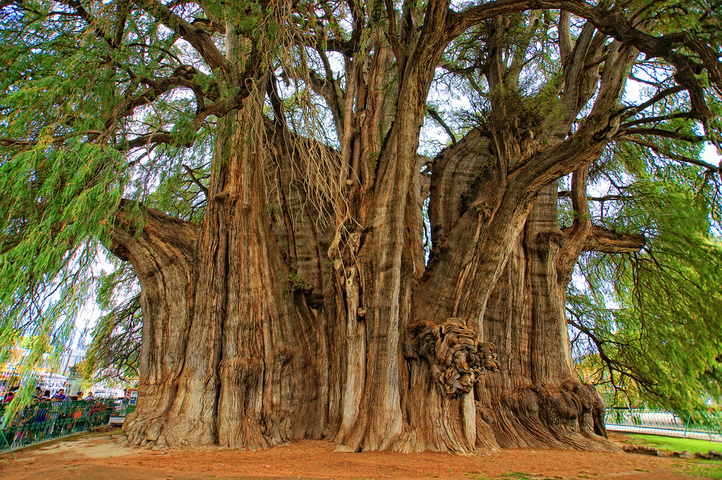
BST Searching
El Árbol del Tule (Spanish for The Tree of Tule) is a tree located in the church grounds in the town center of Santa María del Tule in the Mexican state of Oaxaca, approximately 9 km (6 mi) east of the city of Oaxaca on the road to Mitla. It is a Montezuma cypress and has the stoutest trunk of any tree in the world.
https://en.wikipedia.org/wiki/%C3%81rbol_del_Tule
https://www.flickr.com/photos/expedicaoinfinitahighway/7074862877

Slide 23
Searching in a Binary SEARCH Tree
Start at root node
Examine node data:
Is it desired value? Done
Else, is desired data < node data? Repeat step 2 with left subtree
Else, is desired data > node data? Repeat step 2 with right subtree
Continue until desired value found or a null pointer reached
ROOT
31
19
59
7
null
43
null
null
null
null
null

Slide 24
Searching in a Binary search Tree
To locate the node containing 43,
Examine the root node (31) first
Since 43 > 31, examine the right child of the node containing 31, (59)
Since 43 < 59, examine the left child of the node containing 59, (43)
The node containing 43 has been found
ROOT
31
19
59
7
null
43
null
null
null
null
null

Slide 25
How many algorithm loop iterations?
If you have a 255-node Binary Search Tree (BST), how many algorithm loop iterations will occur when you INSERT a new node?
Use ⌊log₂n⌋ to calculate!
⌊log₂255⌋ = 7

Slide 26
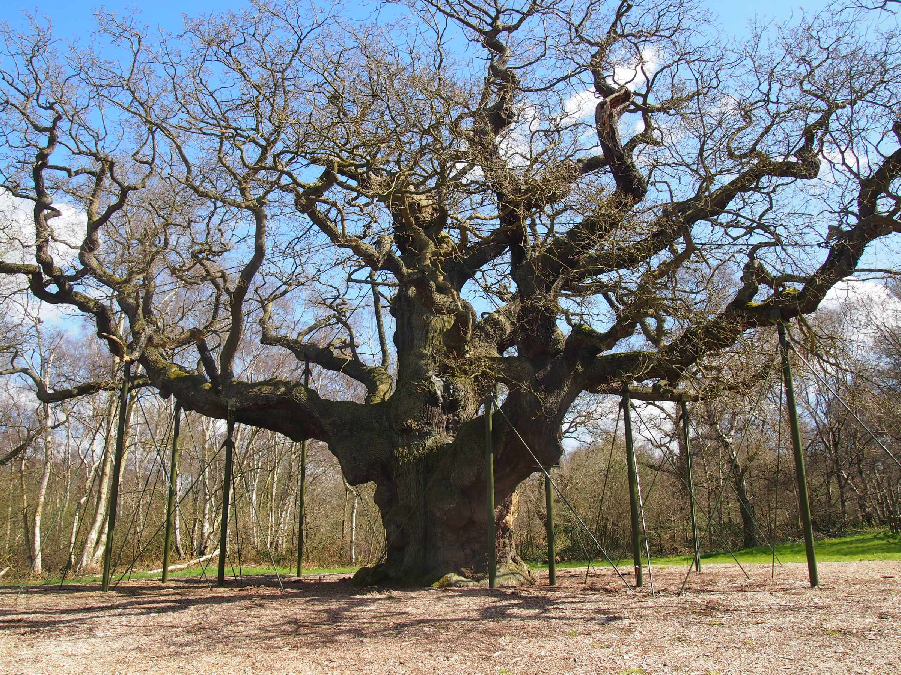
BST operations
The Major Oak is a large English oak near the village of Edwinstowe in the midst of Sherwood Forest, Nottinghamshire, England. According to local folklore, it was Robin Hood's shelter where he and his merry men slept. It weighs an estimated 23 tons, has a girth of 33 feet (10 meters), a canopy of 92 feet (28 meters), and is about 800–1000 years old.
https://en.wikipedia.org/wiki/Major_Oak
https://flickeringlamps.com/2015/05/29/the-major-oak-capturing-the-imagination-for-centuries/

Slide 27
Binary Search Tree Operations
Create a binary search tree – organize data into a binary search tree
Insert a node into a binary tree – put node into tree in its correct position to maintain order
Find a node in a binary tree – locate a node with particular data value
Remove/Delete a node from a binary tree – remove a node and adjust links to maintain binary tree

Slide 28
Binary Search Tree Node
A node in a binary tree is like a node in a linked list,
with two node pointer fields:
struct TreeNode
{
int value;
TreeNode *left;
TreeNode *right;
};

Slide 29
Creating a New Node
newNode
Allocate memory for new node:
newNode = new TreeNode;
Initialize the contents of the node:
newNode->value = num;
Set the pointers to nullptr:
newNode->Left = newNode->Right = nullptr;
newNode
23
newNode
23
null
null

Slide 30
Inserting a New Node in a bst
If tree is empty, insert the new node as the root node
Else, compare new node against left or right child, depending on whether data value of new node is < or > root node
Continue comparing and choosing left or right subtree until null pointer found
Set this null pointer to point to new node

Slide 31
Inserting a New Node (23) in a bst
Examine this node first – value is < node, so go to left subtree
newNode
root
23
Examine this node second – value is > node, so go to right subtree
31
null
null
19
59
7
null
43
null
null
null
null
null
Since the right subtree is null, insert here

Slide 32
Example of Insert Function (nonrecursive)
Folder: Binary Tree Programs > Integer Binary Tree NonRecursive Version
BinaryTree.cpp BinaryTree.h IntegerBinaryTree.cpp

Slide 33
Example of Insert Function (recursive)
Folder: Binary Tree Programs > Integer Binary Tree Recursive Version
BinaryTree.cpp BinaryTree.h IntegerBinaryTree.cpp

Slide 34
Efficiency of insertion in BST – Big O Notation
The BST insert algorithm traverses the tree from the root to a leaf node to find the insertion location. One node is visited per level.
A BST with N nodes has at least log₂N levels and at most N levels. Therefore, the runtime complexity (efficiency) of insertion is best case O(log n) and worst case O(n).
The space complexity of insertion is O(1) because only a single pointer is used to traverse the tree to find the insertion location.

Slide 35
Traversing a Binary Tree
Three traversal methods:
Inorder
Traverse left subtree of node
Process data in node
Traverse right subtree of node
Preorder
Process data in node
Traverse left subtree of node
Traverse right subtree of node
Postorder
Traverse left subtree of node
Traverse right subtree of node
Process data in node

Slide 36
Traversing a Binary Tree
TRAVERSAL METHOD | SHORTCUT L = Left N = root Node R = Right | NODES VISITED IN ORDER
Inorder | L-N-R | 7, 19, 31, 43, 59
Preorder | N-L-R | 31, 19, 7, 59, 43
Postorder | L-R-N | 7, 19, 43, 59, 31
31
19
59
7
null
43
null
null
null
null
null

Slide 37
Example of Traversal
Folder: Binary Tree Programs > Traversal
BinaryTree.cpp BinaryTree.h IntegerBinaryTree.cpp

Slide 38
Searching in a Binary Tree
Start at root node, traverse the tree looking for value
Stop when value found or null pointer detected
Can be implemented as a bool function
31
19
59
7
null
43
null
null
null
null
null
Search for 43? return true
Search for 17? return false

Slide 39
Example of Searching
Folder: Binary Tree Programs > Search
BinaryTree.cpp BinaryTree.h IntegerBinaryTree.cpp

Slide 40
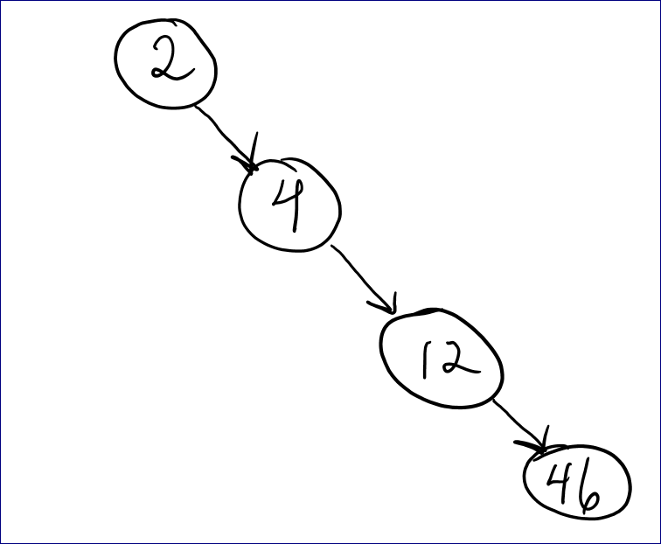
efficiency – Big O Notation
Linked List – searching through list (linear search) is O(n) – could possibly have to look at each node
Binary Search Tree – searching is like the binary search on linked list because you are splitting your search in half each time – so it is usually O(log n) unless you have something like this: insert 2, insert 4, insert 12, insert 46. Then it is O(n) and it looks like a linked list!

Slide 41
Deleting a Node from a Binary Tree – Leaf Node
If node to be deleted is a leaf node, replace parent node’s pointer to it with the null pointer, then delete the node
19
19
7
null
null
null
null
null
Deleting node with 7 – before deletion
Deleting node with 7 – after deletion

Slide 42
Deleting a Node from a Binary Tree – One Child
If node to be deleted has one child node, adjust pointers so that parent of node to be deleted points to child of node to be deleted, then delete the node

Slide 43
Deleting a Node from a Binary Tree – One Child
31
31
19
59
7
59
7
null
43
null
null
null
43
null
null
null
null
null
null
null
Deleting node with 19 – before deletion
Deleting node with 19 – after deletion

Slide 44
Deleting a Node from a Binary Tree – Two Children
If node to be deleted has left and right children then this is the most difficult case.
Zybooks says:
Let’s say the node to be deleted is X.
Locate X’s successor – which is the leftmost child of X’s right subtree.
Copy the successor to X
Then, recursively remove the successor from the right subtree.

Slide 45
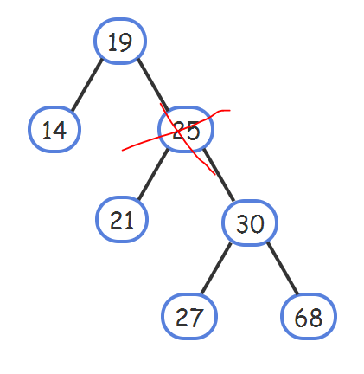
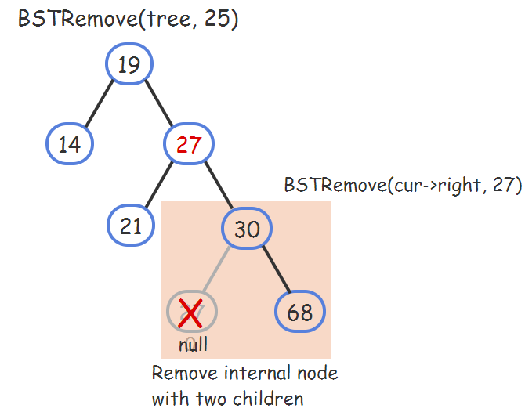
Deleting a Node from a Binary Tree – Two Children
Let’s say the node to be deleted is 25.
Locate 25’s successor – which is the leftmost child of 25’s right subtree. This is the node with 27.
Replace the node to be deleted’s value (25) with the successor (27)
Then, recursively remove the successor (27) from the right subtree.

Slide 46
Example of Delete/Remove
Folder: Binary Tree Programs > Delete > Delete like Zybooks Algorithm
BinaryTree.h
BinaryTree.cpp IntegerBinaryTree.cpp

Slide 47
Efficiency of DELETION in BST – Big O Notation
The BST remove algorithm traverses the tree from the root to find the node to remove. When the node being removed has 2 children, the node's successor is found and a recursive call is made. One node is visited per level, and in the worst case scenario the tree is traversed twice from the root to a leaf.
A BST with N nodes has at least log₂N levels and at most N levels. Therefore, the runtime complexity of deletion is best case O(logN) and worst case O(N).
Two pointers are used to traverse the tree during removal. When the node being removed has 2 children, a third pointer and a copy of one node's data are also used, and one recursive call is made. Thus, the space complexity of removal is always O(1).

Slide 48
Example of creature objects in binary search tree
Folder: Binary Tree Programs > Creature

Slide 49
Template for Binary Search Trees
Binary tree can be implemented as a template, allowing flexibility in determining type of data stored
Implementation must support relational operators >, <, and == to allow comparison of nodes

Slide 50
Example of BST Templates
Folder: Binary Tree Programs > BST Templates
BinaryTree.h IntegerBinaryTree.cpp

Slide 51
Example of String BST
Folder: Binary Tree Programs > String BST
StringBinaryTree.h
StringBSTDriver.cpp

Slide 52
BST Visualization
https://www.cs.usfca.edu/~galles/visualization/BST.html

